Slide 1

Compiler Design
Preet Kanwal
Department of Computer Science & Engineering

Slide 2
Compiler Design
Building a Mini Compiler - Abstract Syntax Tree
Preet Kanwal
Department of Computer Science & Engineering

Slide 3
Compiler Design Implementation tasks
Generating an abstract syntax tree for a single expression.
Keep track of relationship between various nodes of the tree.

Slide 4
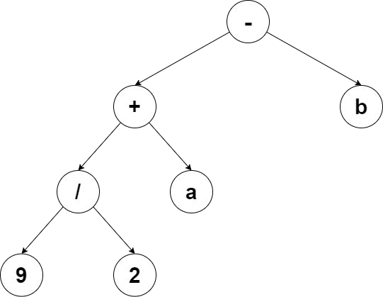
Compiler Design Expected Results
Sample Input:
x = 9 / 2 + a - b
Output
-
+
/ 9
2
a b
Note:
Each line indicates a new node.
Nodes at printed in preorder

Slide 5
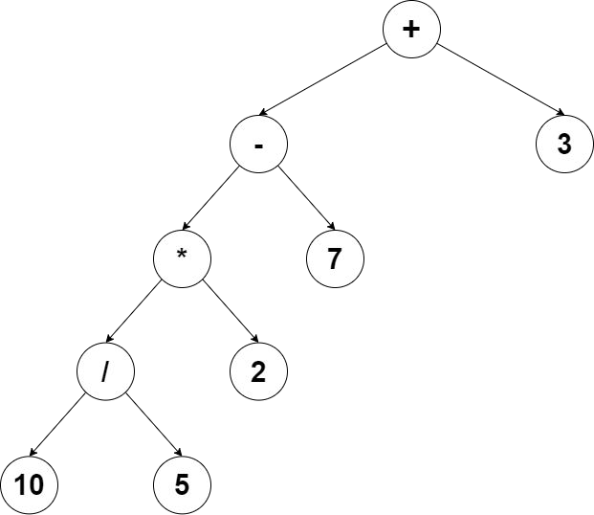
Compiler Design Expected Results
Sample Input:
a = 10 / 5 * 2 - 7 + 3
Output
+
-
*
/ 10
5
2
7
3

Slide 6
Compiler Design Mini-Compiler
Symbol table implementation: yacc file
A binary tree can be used to implement the Abstract Syntax Tree.
An AST is generated only for a valid expression.
ASSGN : T_ID '=' E {
// display the created AST
}

Slide 7
Compiler Design Mini-Compiler
E : E '+' T
{
/* create a new node for the AST with '+' as the value and assign E as the left and T as the right subtree */
}
| E '-' T {
/* create a new node for the AST with '-' as the value and assign E as the left and T as the right subtree */
}
{
| T
// pass previously created node to parent
}
;
T : T '*' F
{
/* create a new node for the AST with '*' as the value and assign T as the left and F as the right subtree */
}
| T '/' F {
/* create a new node for the AST with '/' as the value and assign T as the left and F as the right subtree */
}
{
| F
// pass previously created node to parent
}
;

Slide 8
Compiler Design Mini-Compiler
F : '(' E ')' {
// pass previously created node to parent
}
| T_ID
{
/* create a new node for the AST with T_ID as the value and assign left and right subtree as NULL */
}
| T_NUM
{
/* create a new node for the AST with T_NUM as the value and assign left and right subtree as NULL */
}
;

Slide 9
Compiler Design Mini-Compiler
Expression Evaluation implementation: yacc file
Expression grammar can extend to multiple rules, to connect the right nodes, you need to create child nodes and pass them to the parent nodes.
It is similar to the process used to generate the symbol table. The required values are passed from lower rules to the root.
Let’s take an example expression: 45 + 24;
Let the grammar be: E: E ‘+’ T | T
T: T_NUM

Slide 10
Compiler Design Mini-Compiler
Important points:
You will have to create helper functions for the abstract syntax tree. (example: initialise nodes and assign children)
You will have to make use of additional structures in the yacc file in order to pass values and addresses to the parent nodes.
In the previous lab, all grammar rules returned strings, however in this lab you will need to make use of other types (i.e. structures) as well

Slide 11
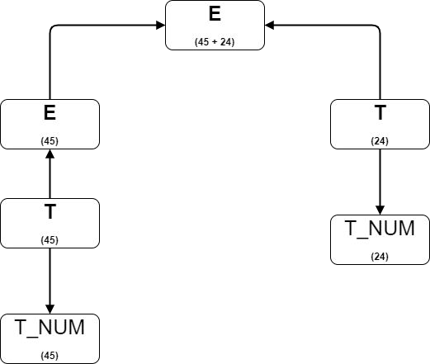
Compiler Design Mini-Compiler
Node with value ‘+’ is created, connected to node 45 and node 24 and is passed upwards to EXPR
Node with value 24 is created and passed upwards to E
Node with value 45 is created and passed upwards to E

Slide 12
Compiler Design Mini-Compiler
So our grammar would look like this
E : E ‘+’ T {$$ = new_node(‘+’);}
| T {$$ = $1;}
T: T_NUM {$$ = new_node(45);}

Slide 13
Compiler Design Mini-Compiler
Note:
The different rules in the yacc file will return different types.
Ensure that YYSTYPE is NOT defined. As this will override any other type definitions you make in the yacc file.
To define what type a given terminal or non-terminal will return, you will need to create a union. Assuming the return types used are int, char* and an AST struct pointer, the following union can be used:
%union
{
int i; char* text;
struct ast* ast_t;
}

Slide 14
Compiler Design Mini-Compiler
Note:
After defining the union, you will need to define what type (if any) a given terminal or non-terminal will return.
For example:
Assuming the following union is defined:
%union
{
int i; char* text;
struct ast* ast_t;
}
T_ID is a terminal that returns a struct defined in the union.
/* defining the terminal return type */
%token <ast_t> T_ID
E is a non-terminal that returns the same struct.
/* defining the non-terminal return type */
%type <ast_t> e

Slide 15
THANK YOU
Preet Kanwal
Department of Computer Science & Engineering
preetkanwal@pes.edu

